Slide 1
“Molecular chaperone-mediated rescue of mitophagy by a Parkin ring1 domain mutant” Rose, Johanna M., Novoselov, Sergey S., Robinson, Philip A., and cheetham, michael E. Human molecular Genetics Vol. 20 (2011): 16-27. Print. Presented by: Trevor Baugher

Slide 2
Outline
Introduction/Background/Objectives
Description of Exact Players Involved
Sequential Experimental Approaches
Testing Functions Under No Inducive Signal
Proving Aggregates of Parkin are Protein
Tests Showing Failure of RING1 Mutants to Localize to Damaged Mitochondria
Tests Confirming Parkin Induces Autophagy/RING1 Domain Mutant Does Not
Tests for Confirming Gain of Various Functions of Parkin by Chaperone Protein
Take Home Message
Conclusion/Future Studies

Slide 3
Introduction/Background/Objectives
Parkinson’s Disease
Common/Degenerative
One Characteristic (inhibiting Parkin folding; autophagy)
Three Specific Domains
1 Ubl (N-term), 2 RING (C-term)
RING1 Domain Governs Proper Function
RING1 Governs Proper Folding/Structure
WT Parkin Can be Influenced by Uncouplers
carbonyl cyanide m-chlorophenylhydrazone (CCCP)
Aiming for Regain of Function by Chaperone
Assist in Proper Folding/Aggregation Prevention
HSJ1/1 J Domain (N-term), 2 UIM Domains (C-term)

Slide 4
Some of the Major Players
FLAG-Parkin(WT)
FLAG-Parkin(R42P)
FLAG-Parkin(C289G)
HSJ1a(WT)
HSJ1a(H31Q)
HSJ1a(∆UIM)

Slide 5
Some Techniques of the Experimental Approaches
Fluorescence Microscopy
Staining
GFP: Hsp70 (Parkin), LC3 (Autophagy Marker)
MitoDsRed (mitochondria)
Gene Expression by Transfection
SK-N-SH (neuroblastoma cells)

Slide 6
Experimental Approaches: Test 1: Testing Functions Under No Inducive Signal
Players
GFP-Hsp70, Parkin(WT), Parkin(C289G), Parkin(R42P)
Reason for Test
Observe Normal Functions of Strains with no Treatment of Uncoupling Agents
Observe Aggregation Activity (inclusion bodies)
Results of Aggregation
Parkin(WT)= 5% of cells
Parkin(R42P)= 22% of cells
Parkin(C289G)= 86% of cells

Slide 7
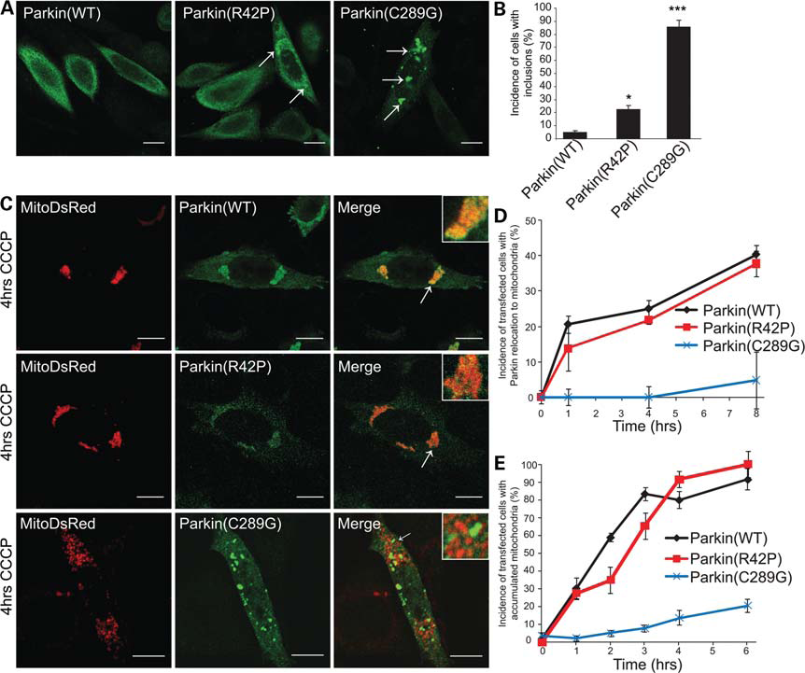

Slide 8
Test 2: Proving Aggregates of Parkin are Protein
Players
GFP-Hsp70, Parkin(C289G)
Reason for Test
Confirm That Aggregates Being Observed are from Misfolded Protein
Results
Inclusion Bodies Tested Positive for Hsp70

Slide 9
Test 3: Test Showing Failure of RING1 Mutants to Localize to Damaged Mitochondria
Players
MitoDsRed, GFP-Hsp70, carbonyl cyanide m-chlorophenylhydrazone(CCCP)(depolarization), Parkin(WT), Parkin(C289G), Parkin(R42P)
Reason for Test
Observe Localization/Perinuclear Inclusions
Observe Quantitative Overlap (% cells)
Will Show Which Parkin Domain Governs Function
Results
Parkin(WT)= Significant Overlap(91% of cells)
Parkin(R42P)= Significant Overlap(100% of cells)
Parkin(C289G)= Little Overlap(2% of cells)

Slide 11
Test 4: Tests Confirming Parkin Induces Autophagy/RING1 Domain Mutant Does Not
Players
MitoDsRed, CCCP, GFP-LC3 (autophagy marker), Parkin(WT), Parkin(C289G)
Reason for Test
Observe That RING1 Mutant Cannot Induce Autophagy on its Own
Observe Overlap Between Markers
Shows That RING1 Domain is Responsible for Autophagy (and Protein Misfolding)
Results
Parkin(WT)= Significant Overlap
Parkin(C289G)= Little to No Overlap
RING1 Causes Inclusion Body Formation, Non-localization and Now No Autophagy

Slide 12
Tests for Confirming Gain of Various Functions of Parkin by Chaperone Protein: Test 5: HSJ1a Reduces Inclusion Body Formation of RING1
Players
GFP-Hsp70, Parkin(C289G), HSJ1a(WT), HSJ1a(H31Q), HSJ1a(∆UIM)
Reason for Test
Observe the Incidence of Inclusion Bodies
Determine Which Domain in HSJ1a Holds the Function of the Chaperone
Shows if HSJ1a Can Prevent Inclusion Bodies
Results
HSJ1a(WT)/Parkin(C289G)= Significant Reduction of Inclusion Bodies (from 81% to 17%)
HSJ1a(H31Q)/Parkin(C289G)= No Reduction
HSJ1a(∆UIM)/Parkin(C289G)= Significant Reduction (from 81% to 27%)

Slide 13
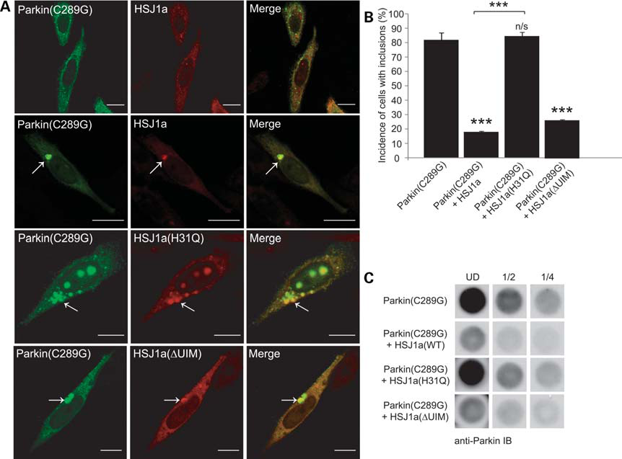

Slide 14
Test 6: Test Effects of HSJ1a Variants on Restoring Localization of Parkin
Players
GFP-Hsp70, MitoDsRed, CCCP, Parkin(WT), Parkin(C289G), HSJ1a(WT), HSJ1a(H31Q), and HSJ1a(∆UIM)
Reason for Test
Observe Localization of Parkin(C289G) to Mitochondria
Quantitate Overlap of Markers
Shows if HSJ1a Can Restore Localization
Results
Parkin(C289G)/HSJ1a(WT)= Significant Overlap
Parkin(C289G)/HSJ1a(H31Q)= No Overlap
Parkin(C289G)/HSJ1a(∆UIM)= Significant Overlap

Slide 15
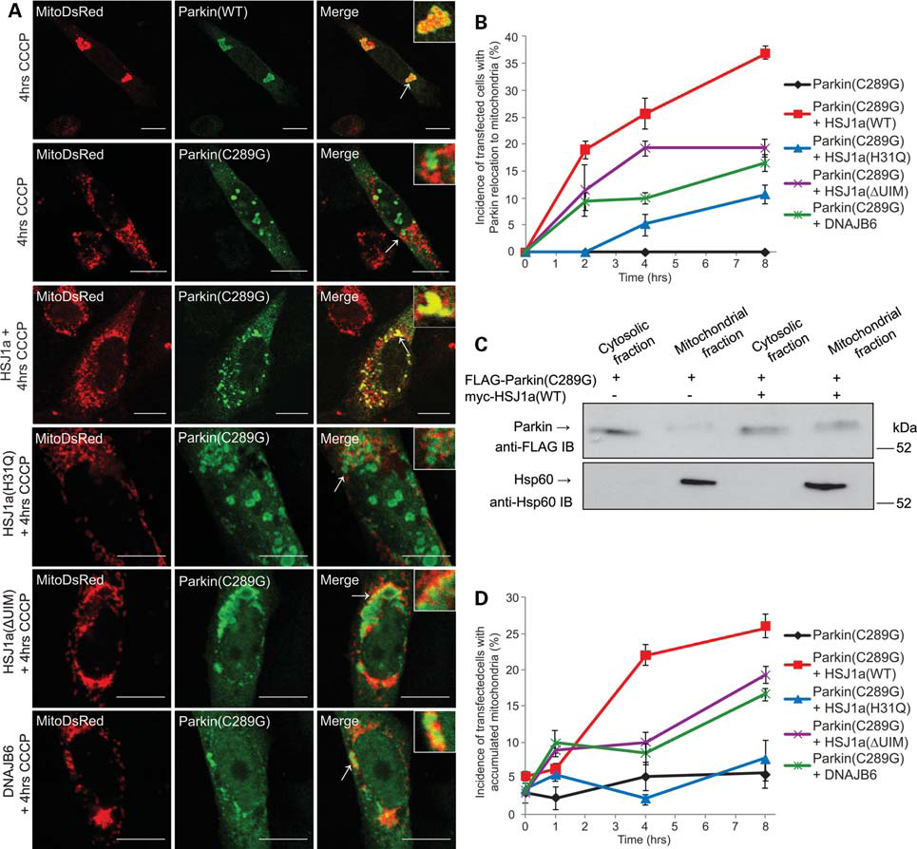

Slide 16
Test 7: Testing the Effects of HSJ1a on the Rescue of Autophagy
Players
Red Fluorescent Hsp60, GFP-LC3, Parkin(WT), Parkin(C289G), HSJ1a
Reason for Test
Observe Induction of Autophagy by Parkin
Quantitate Overlap of Markers
Shows if HSJ1a Can Restore Autophagy
Results
Parkin(WT)= Significant Overlap (68%)
Parkin(C289G)= No Overlap
Parkin(C289G)/HSJ1a(WT)= Some Overlap (from 0% to 16%)

Slide 17
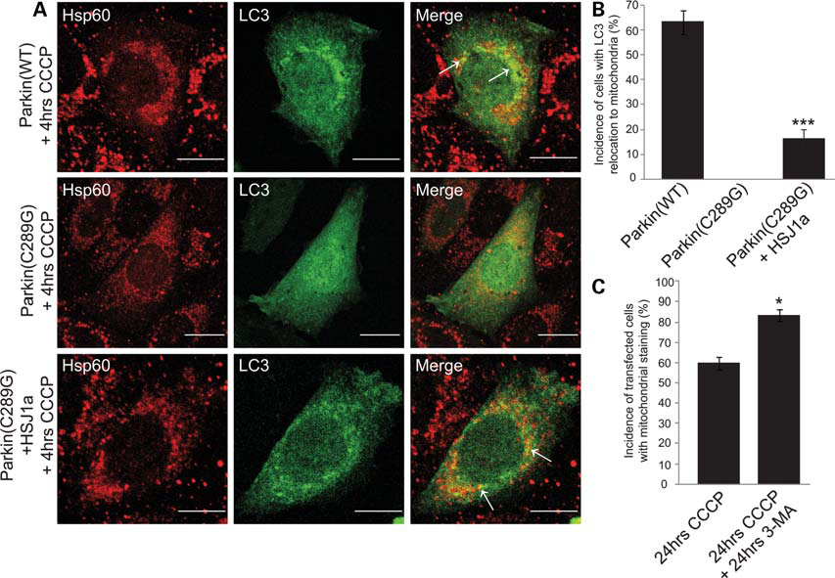

Slide 18
Take Home Message
HSJ1a Can Save Several Functions of the RING1 Domain
Inclusion Bodies
Relocalization
Autophagy
J Domain in HSJ1a is Key
Sheds Light on Important Information in Prevention of Parkinson’s Disease Effects

Slide 19
Conclusion/Future Studies
HSJ1a(∆UIM) Always Functions at an Intermediate Level
HSJ1a(WT)= Almost Full Restoration of Functions
HSJ1a(∆UIM)= Restoration, But Not as Much
HSJ1a(H31Q)= Minimal Restoration
UIM Domain, Possible Enhancer
Conformational Change to More Induced Fit to Parkin(C289G)
Research
Replace UIM Domain With Other Functional Domain
Invert UIM by Floxing/ See if This Decreases Function of J Domain

Slide 20
Thank You!

